Slide 1


RECOMMENDER SYSTEMS?
A recommender system in machine learning is a type of algorithm designed to suggest relevant items or content to users based on their preferences, behavior, or data. The system predicts and ranks items a user is likely to engage with, helping personalize their experience.
BY PEELA JAHNAVI AP22110010382 CSEL

Slide 2
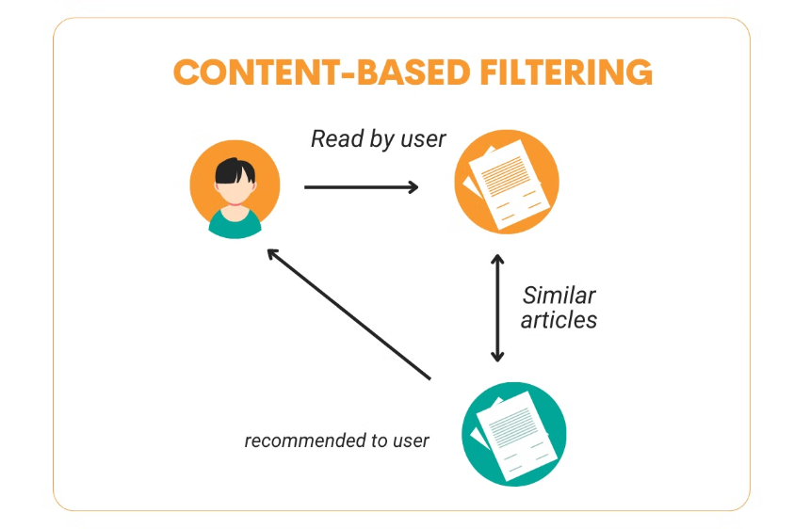
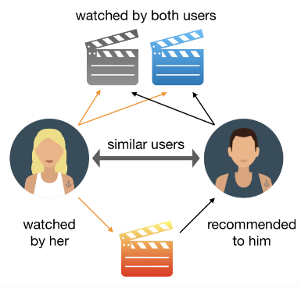
Types of Recommender Systems
Content Based Filtering
Collaborative Filtering
Content-based filtering recommends items based on the characteristics (content) of items and the user’s past interactions with similar items. It focuses on finding items with similar features or attributes to those the user has previously shown interest in.
Collaborative filtering recommends items by analyzing user behavior patterns and interactions. It finds similar users or items and bases its recommendations on the preferences of other users with similar tastes.

Slide 3

CASE STUDY:
Stock Market Recommendation System
In the world of finance, machine learning has revolutionized how we approach stock market recommendations. This case study explores two key components: Collaborative Filtering and Content-Based Filtering. These techniques are essential in providing personalized investment advice to users, helping them navigate the complex world of stock markets with greater confidence and precision.

Slide 4
Comparing Betterment and Personalized Stock Investment Advisor
Betterment
Personalized Stock Advisor
Comprehensive portfolio management
Individual stock recommendations
Focuses on portfolio diversification.
Assists with specific stock decisions
Long-term financial planning
Ideal for active stock investors

Slide 5
Collaborative Filtering
Collaborative Filtering
Utilizes shared user behavior to suggest stocks.
Assumes that users with similar investment patterns will like similar stocks.
Includes two types:
User-based, recommending stocks liked by similar users.
Item-based, recommending stocks similar to those in the user’s portfolio
Data Collection
1
Gather user behavior data on stock interactions
2
Matrix Construction
Build user-stock interaction matrix
Similarity Computation
3
Calculate user or stock similarities
4
Recommendation
Suggest stocks based on computed similarities

Slide 6


Matrix Factorization in Collaborative Filtering
Matrix factorization is a key technique in collaborative filtering.
It breaks down the user-stock matrix into smaller matrices to uncover hidden factors driving preferences.
This approach enhances recommendation accuracy and manages data sparsity in large systems.
Matrix Decomposition
Latent Factors
A large matrix is broken down into smaller, more manageable matrices.
Hidden factors connecting users and stocks, revealed through matrix factorization.

Slide 7
Strengths and Challenges of Collaborative Filtering
Strengths
Challenges
Can provide diverse and unexpected recommendations
Cold start problem for new users or new stocks
Needs substantial user data for accurate recommendations
Leverages shared user patterns and preferences
Effective for popular stocks with significant interaction data
Limited with niche stocks or sparse data

Slide 8

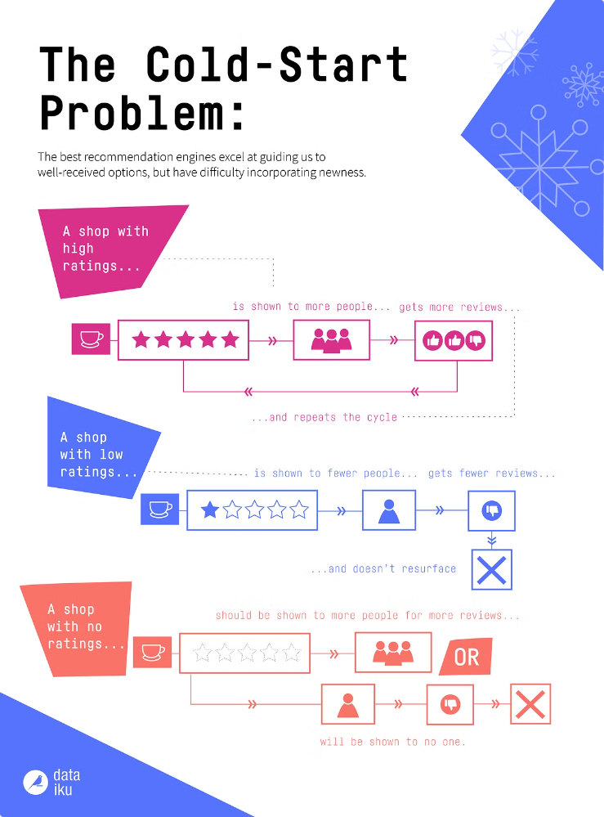
COLD START PROBLEM?
The cold start problem is a common challenge in recommendation systems, where the system struggles to make accurate recommendations for new users or new items due to a lack of data.
Types of Cold Start Problems: New User Problem New Item Problem New System Problem

Slide 9
Content-Based Filtering: Focusing on Stock Attributes
Content-based filtering recommends stocks based on their attributes.
It analyzes features like market cap, sector, and financial ratios to find matching stocks.
The system tailors recommendations to each user's investment style by creating a personalized profile.
Sector
Market Cap
Technology, healthcare, finance, etc.
Large-cap, mid-cap, small-cap
Financial Ratios
Risk Metrics
P/E ratio, EPS, etc.
Volatility, dividend yield

Slide 10

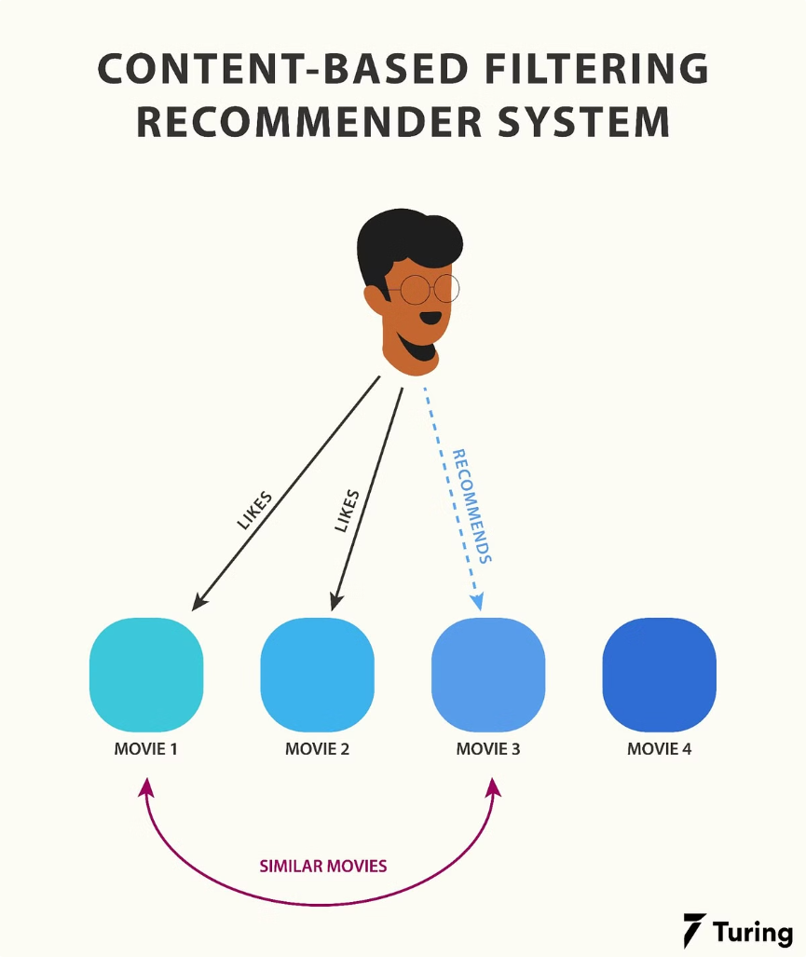




The Content-Based Filtering Process
The content-based filtering process involves several key steps to provide accurate stock recommendations. It begins with creating detailed profiles for both stocks and users, followed by similarity calculations and final recommendations.
Stock Profile Creation
Each stock is described by a set of features, stored in a feature vector.
User Profile Creation
A user profile is generated based on the stocks they've interacted with or invested in.
Similarity Calculation
The system computes the similarity between the user's profile and available stocks.
Recommendation
Stocks with high similarity to the user's profile are suggested.

Slide 11
Strengths and Challenges of Content-Based Filtering
Strengths
Challenges
Highly personalized recommendations
Limited discovery of diverse stocks
No cold start problem
Complex feature engineering required
Can recommend new or rare stocks
Dependence on accurate stock data

Slide 12

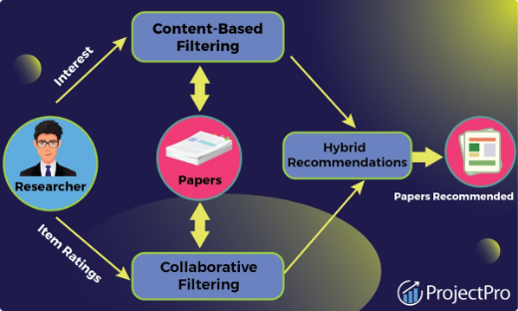



Hybrid Model: Combining Collaborative and Content-Based Filtering
Collaborative Input
Content-Based Input
Hybrid Output
Recommendations based on similar user behaviors
Suggestions aligned with stock attributes
Diverse and personalized stock recommendations

Slide 13

SUMMARY
This system analyzes individual stocks to provide buy, sell, or hold recommendations based on various factors including historical performance, technical indicators, user behavior, and market trends.
The machine learning techniques employed typically include collaborative filtering or content-based filtering to recommend stocks based on user behavior or stock attributes. The primary focus is on individual stock selection rather than overall portfolio composition.
Focus
Individual stock recommendations
Analysis
Historical performance, technical indicators
ML Techniques
Collaborative and content-based filtering
Output
Buy, sell, or hold recommendations

Slide 14


